Slide 1
Capstone Project
Telecom Churn Analysis
Individual Project Annamaneni Ajay

Slide 2
Contents…
1. Defining problem statement.
2. Summary regarding the data set
3. Explore the data set
4. Analyse the data set
5. Insights obtained from Analysis and also recommendations.

Slide 3
Problem Statement
With the rapid development of telecommunication industry, the service providers are inclined more towards expansion of the subscriber base. To meet the need of surviving in the competitive environment, the retention of existing customers has become a huge challenge. In the survey done in the Telecom industry, it is stated that the cost of acquiring a new customer is far more that retaining the existing one.

Slide 4
Problem Statement
Objective :
Orange S.A., formerly France Telecom S.A, is a French multi national telecommunications corporation. We are given with the Orange Telecom’s churn Dataset, consists of cleaned customer activity data(features), along with a churn label specifying whether a customer cancelled the subscription or not. The idea of this project is to identify why users are churning to another Telecom service and recommend the measures to be taken to stop user churn. In order to complete this task I will initially proceed with knowing about features in the data set and then analysing and exploring the dataset.

Slide 5
Data Summary…
- There are a total of 20 columns and 3333 rows in our data set. Out of 20 columns/features 19 are independent variables and ‘Churn’ is the only dependent variable. So lets get to know about the features in data set
State: This depicts us to which State a user belong to.
Account length: This might depict us the validity period chosen by the users.
Area code: This depicts to which area the user belongs to.
International Plan: This depicts whether the user has chosen for international plan or not(either Yes or NO).

Slide 6
Data Summary…
Voice mail plan: This depicts us whether the user has chosen for voice mail plan or not (either Yes or No).
Number vmail messages: This depict us the total number of voice mail messages sent or received by user.
Total Day minutes: This depicts us the total number of day minutes the user have called to others through our service.
Total Day calls: This depicts us the total number of day calls the user have called to others through our service.

Slide 7
Data Summary…
Total Day charge: It is the bill for which the user has to pay for day calls
Total eve minutes: This depicts us the total number of evening minutes the user have called to others through our service.
Total eve calls: This depicts us the total number of evening calls the user have called to others through our service.
Total eve charge: It is the bill for which the user has to pay for evening calls.

Slide 8
Data Summary…
Total night minutes: This depicts us the total number of night minutes the user have called to others through our service.
Total night calls: This depicts us the total number of night calls the user have called to others through our service.
Total night charge: It is the bill for which the user has to pay for night calls.
Total intl minutes: This depicts us the total number of international minutes the user have called to others through our service.

Slide 9
Data Summary…
Total intl calls: This depicts us the total number of intl calls the user have called to others through our service.
Total intl charge: It is the bill for which the user has to pay for international calls.
Customer Service calls : This depicts us the total number of times a user have called to customer service for complaining about the problem he faced.
Churn: This depicts us whether the user has churned to another network or not(either True or False)

Slide 10

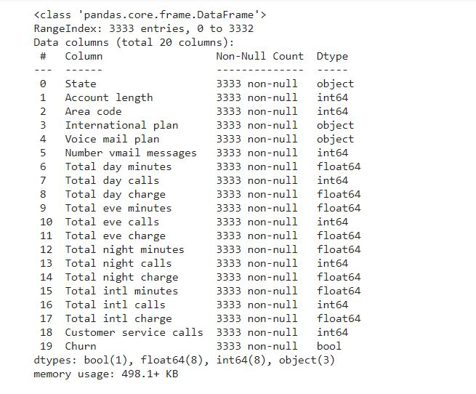
Data set exploration…
The Telecom churn data set consists of 3333 rows and 20 columns
Also, the data set do no contain
any null/NAN values.
The data type of various columns
is also displayed on right.
The data set contain 1 column
which is Boolean, 8 columns which
are float64, 8 columns which are
int64, 3 columns which are object
type.

Slide 11
Data set exploration…
- NULL Values : Missingno is a Python library that provides the ability to understand whether the columns contain missing values through informative visualizations. The visualizations can be in the form of heat maps or bar charts. With this library, it is possible to observe where the missing values have occurred. Since the above data set doesn't contain any null values the visualization is uniform across all columns but if we consider data set which has null values and if we apply missingo library then the we can see few lines in the columns where null values are present. .

Slide 12
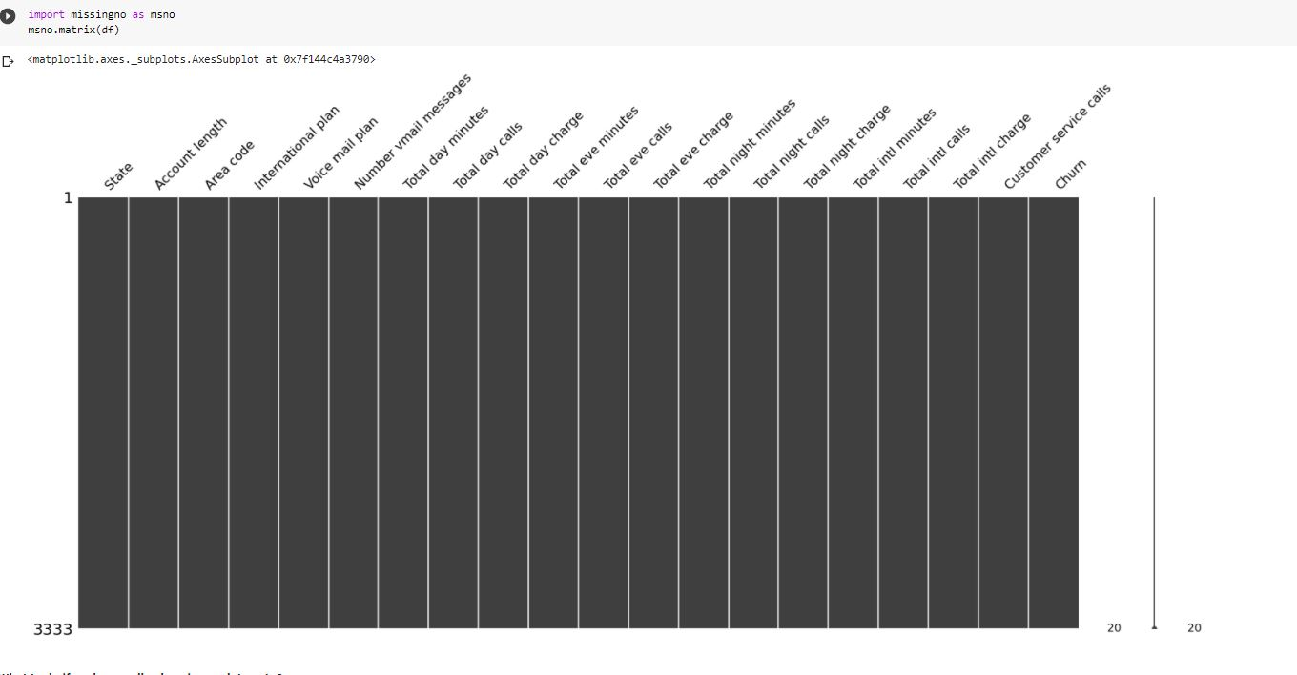
Data set exploration…
.

Slide 13
Data set exploration…
Lets us check the corelation between the specific columns by plotting a heatmap. Heat map depicts how a column is related to other column. If it is completely dependent then the value is 1 else it decreases up to -1
for example :Total night charge and Churn are very less related since the value is 0.035.
.

Slide 14
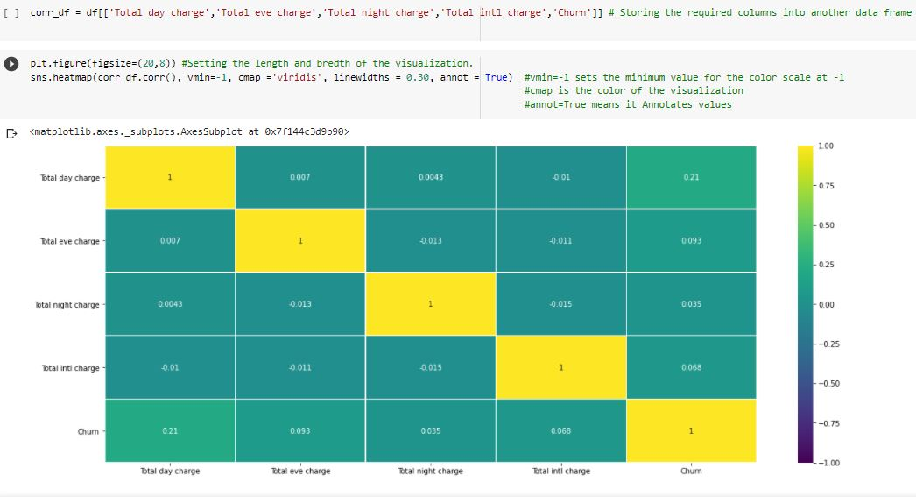
Data set exploration…
.

Slide 15
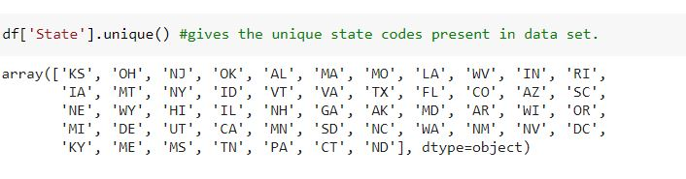
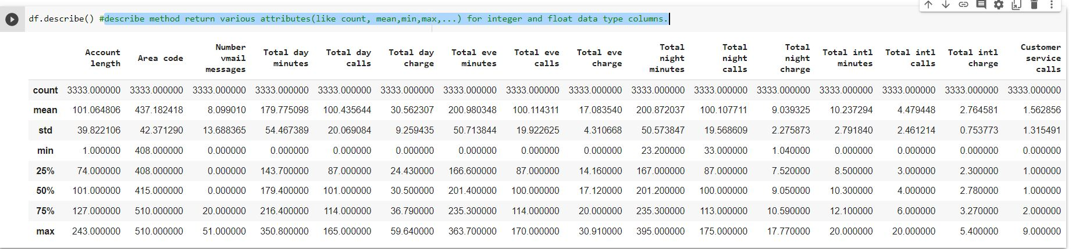
Data set exploration…
Let us check for the unique State codes present in data set.
- Describe method returns various attributes(like count, mean,..)for integer and float data type columns.

Slide 16
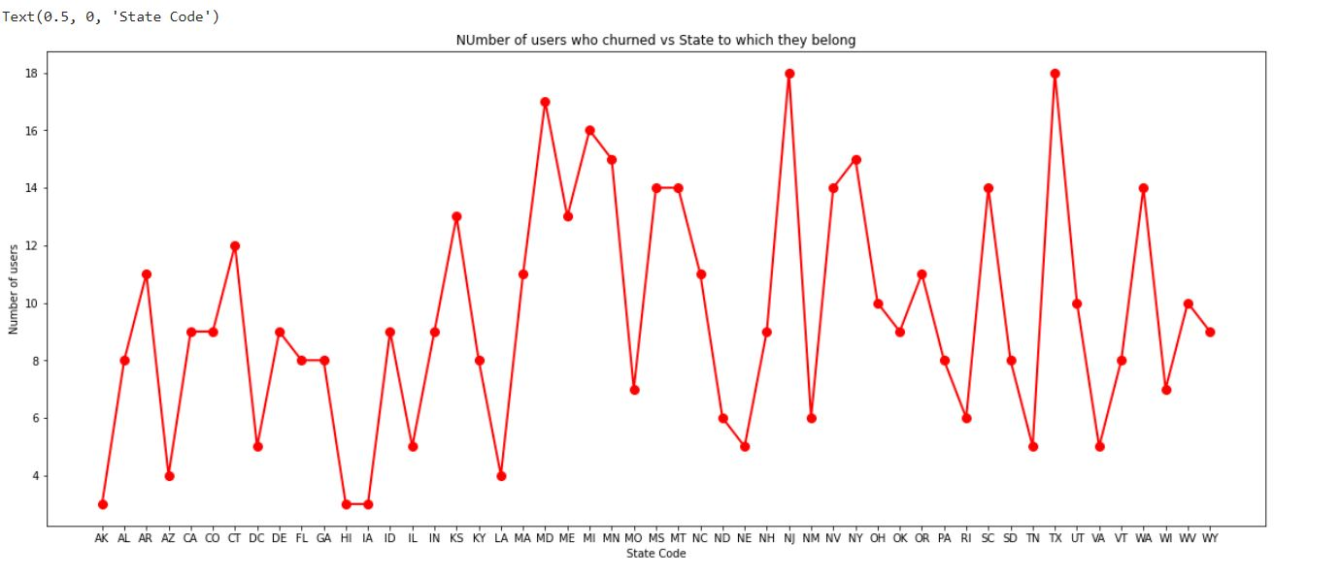
Analysing Data
1. Let us analyse which state has maximum people churning to another network.

Slide 17
Analysing Data
1. Let us analyse which state has maximum people churning to another network.
Insight-1 : People in the states (NJ and TX) are more churning to another company compared with another states. This might be because the people from those areas are facing low network issues.
Insight-2 : States (AK, HI, IA) have the least number of people who churn. This might be because the people might not be facing any issues.
Recommendation-1 : .The Telecom company should focus more on areas NJ and TX and improve the infrastructure in those areas to stop churn.

Slide 18
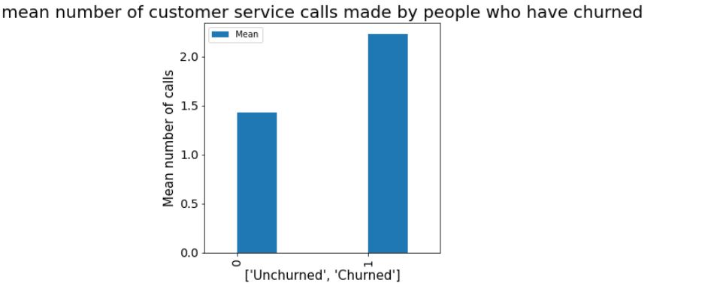
Analysing Data
2. Let us check how many times the churned people called to customer service and compare it with number times the churned people called to customer service.
Customer Service Calls : This depicts us the total number of times a user have called to customer service for complaining about the problem he faced.

Slide 19
Analysing Data
2. Let us check how many times the churned people called to customer service and compare it with number times the churned people called to customer service.
Insight-3 : From the above graph it is clear that people before
churning have made more number of calls to customer
Service(greater than 2 on an average), may be for complaining regarding an issue. Since the problem isn’t resolved even after complaining they might have churned to another network.

Slide 20
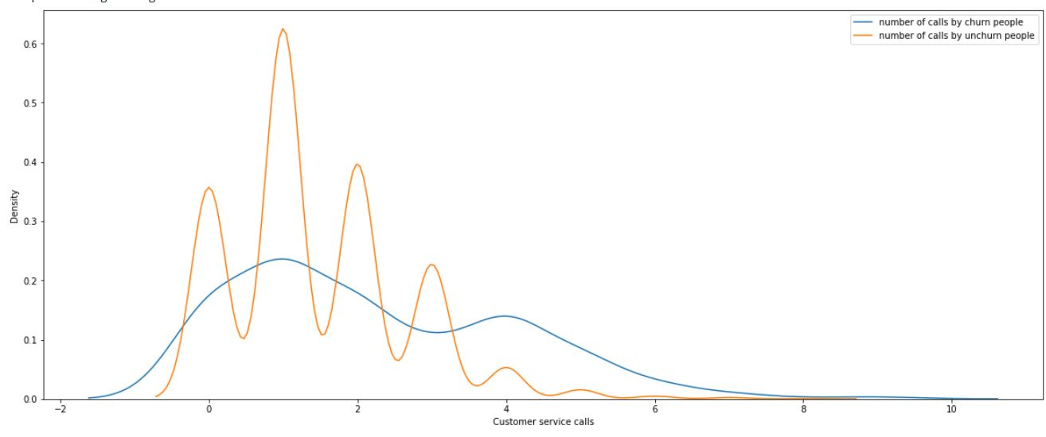
Analysing Data
Blue line depicts the number of calls made to customer service for complaining by churned
people.
Orange line depicts the number of calls made to customer service for complaining by un-churn people

Slide 21
Analysing Data
2. Let us check how many times the churned people called to customer service and compare it with number times the churned people called to customer service.
Insight-4 : From the above dist plot it is clear there are people call customer care once or twice and get there problem solved but we can see that even after people calling customer care for 4 to 8 times their problems are not getting fixed as a result they are churning.
- Blue line depicts churn people Orange line depicts un-churn people
Recommendation-2 : Improving customer service and taking quick action on complaints filed might stop people churning to another network.

Slide 22
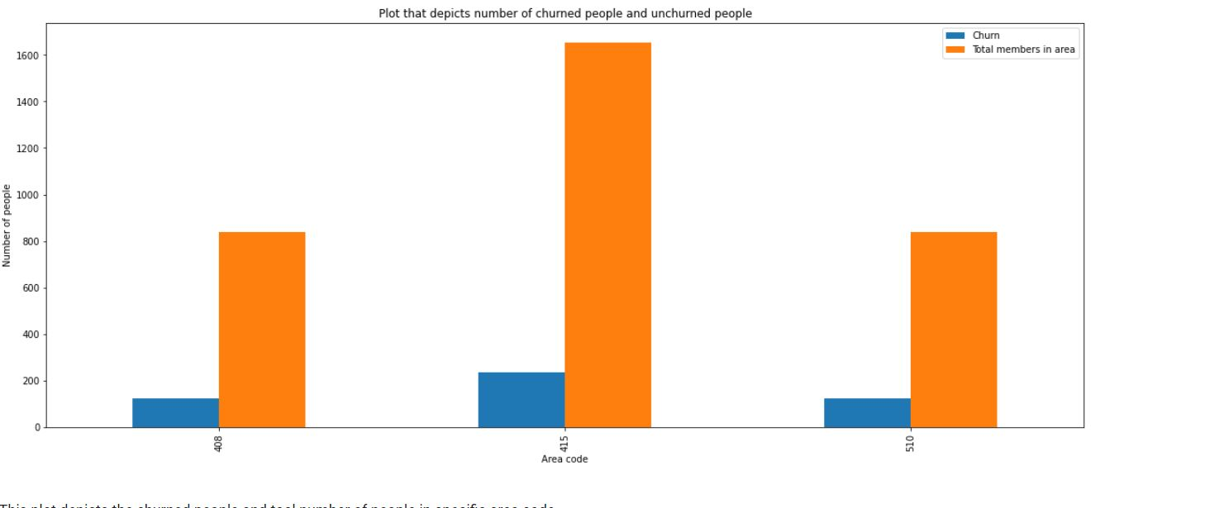
Analysing Data
3. Analyze the customers who have churned based on area code.

Slide 23
Analysing Data
3. Analyze the customers who have churned based on area code.
Insight-5:
This plot depicts the churned people and total number of people in specific area code.
In area code 415 there are highest number users and
less number of people who churned.

Slide 24
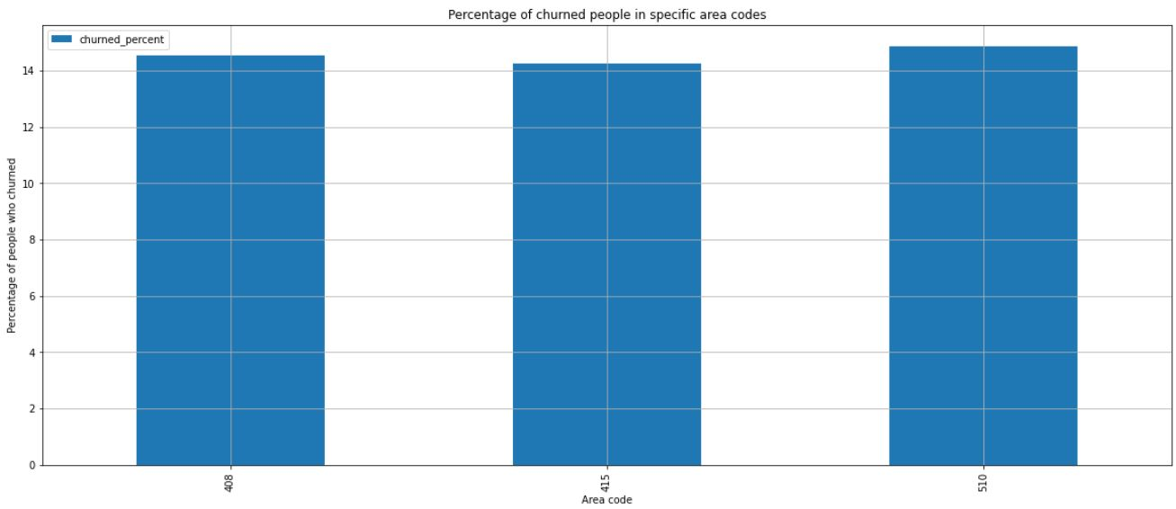
Analysing Data
3. Analyze the customers who have churned based on area code.

Slide 25
Analysing Data
3. Analyze the customers who have churned based on area code.
Insight-6 :
From the above two graphs it is clear that area code 415 has more number of users then followed by 510 and 408.
But More percentage of people who churned are from area code 510 and then followed by 408 and 415.
Recommendation-3 : The company has to more focus on area codes 408 and 510 and solve problems faced by people so that people do not churn from network.

Slide 26
Challenges
Had to refer various blogs for making the visualization look colorful and easily understandable.
Had to go through documentations of various functions for syntax.

Slide 27
Conclusion..
People in the states (NJ and TX) are more churning to another company compared with another states. This might be because the people from those areas are facing low network issues.
States (AK, HI, IA) have the least number of people who churn. This might be because the people might not be facing any issues.
People before churning have made more number of calls to the customer service, may be for complaining regarding an issue. Since the problem was not resolved even after calling many times, they might have churned.
- In area code 415 there are highest number users and
less number of people who churned.

Slide 28
Conclusion..
The area code 415 has more number of users then followed by 510 and 408.
But More percentage of people who churned are from area code 510 and then followed by 408 and 415.

